Slide 1

Load Balancing In Fog Network
VI Sem Minor Project
Course Code:15ECSW302
Team Number: N11
Manisha Belagal | 01FE19BCS207
Mehar Anjum Soudagar | 01FE19BCS208
Devyansh Agrawal | 01FE19BCS245
Chetan N Shet | 01FE19BCS255
Under the guidance of
Dr. Vijeth Kotagi
2021 – 2022 Even semester
SoCSE, KLE TECHNOLOGICAL UNIVERSITY-HUBLI

Slide 2

Domain
Networking
Sub Domain: Fog Computing

Slide 3
Problem Statement
To design and implement an effective distributed load balancing algorithm in a fog network.

Slide 4
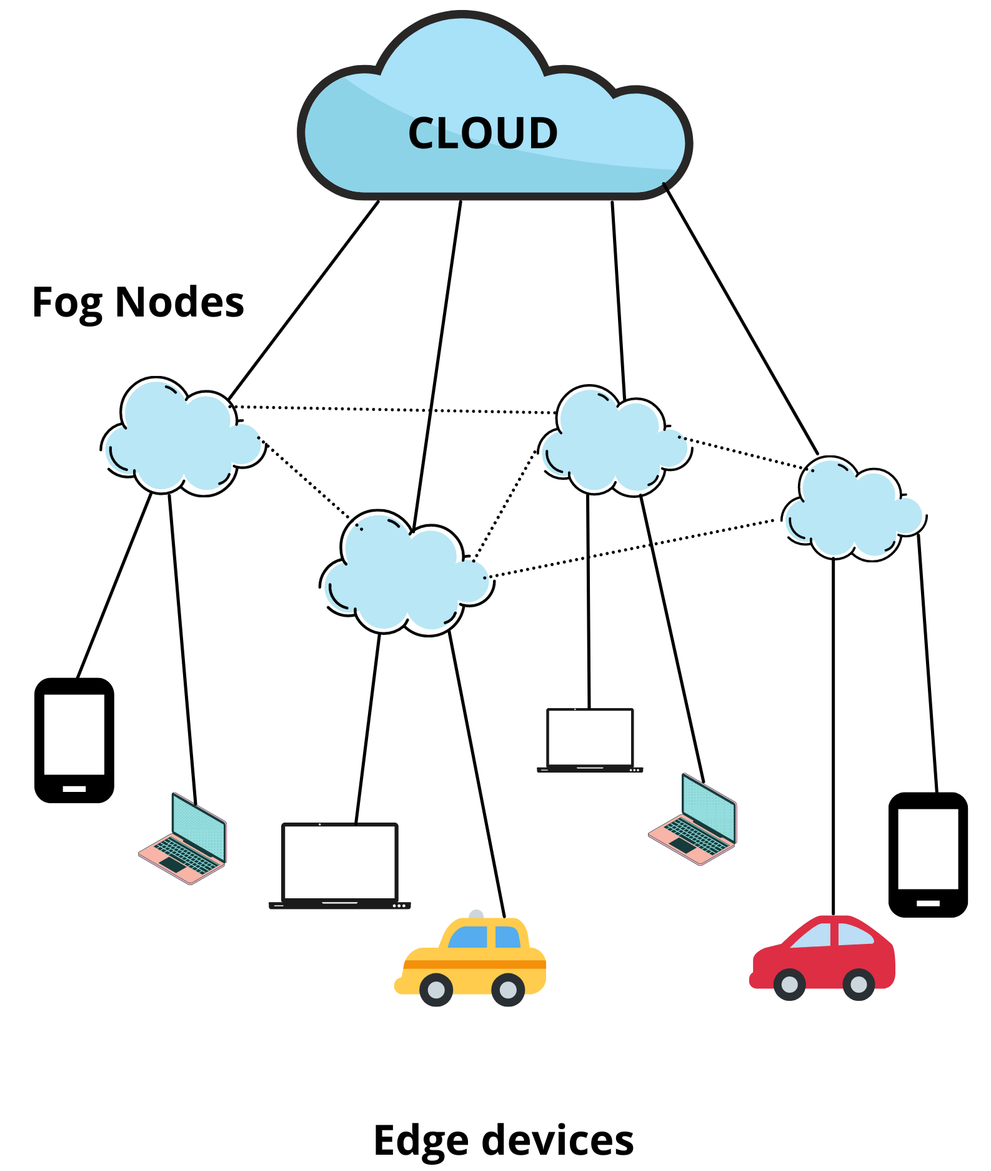
Problem Statement Description

Slide 5
Motivation
The advancement in computing and wireless technologies has led to increase in the use of IoT(Internet of Things) devices.
Cloud server’s are distributed across geographically different data centers. Critical applications such as emergency responses, medical responses which require immediate replies cannot depend on cloud so we have to bring the computation closer to the end devices.
Fog computing is an alternative solution to minimize end-to-end latency which occurs due to large distances.
Fog network faces some challenges: if large amount of data is being processed in the fog network it leads to the overloading of the fog node.
Therefore it is necessary to offload the requests and distribute the load on each fog node.

Slide 6
Objectives
To minimize overloading of fog nodes.
To make an effective dynamic offloading decisions.
To determine the number of tasks to be offloaded.
To minimize request processing time and hence its latency.

Slide 7
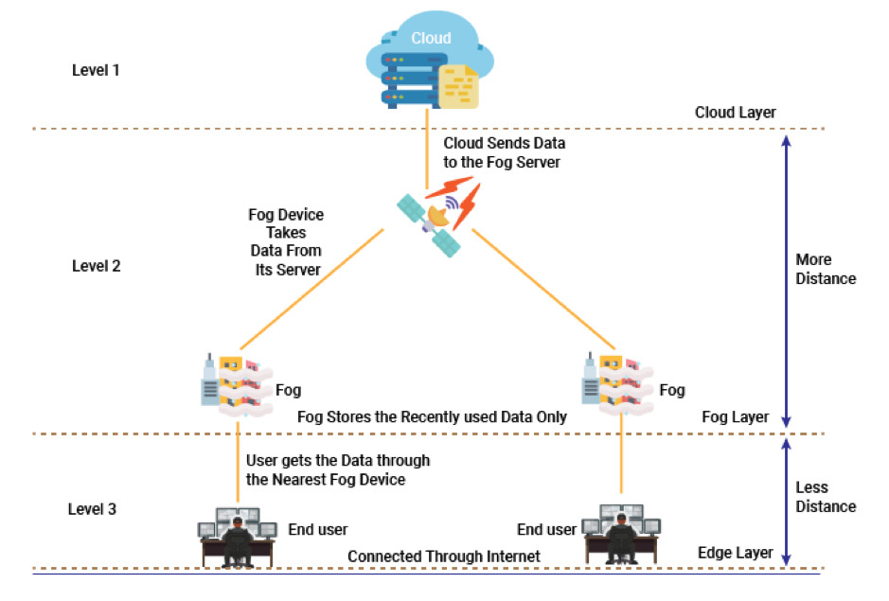
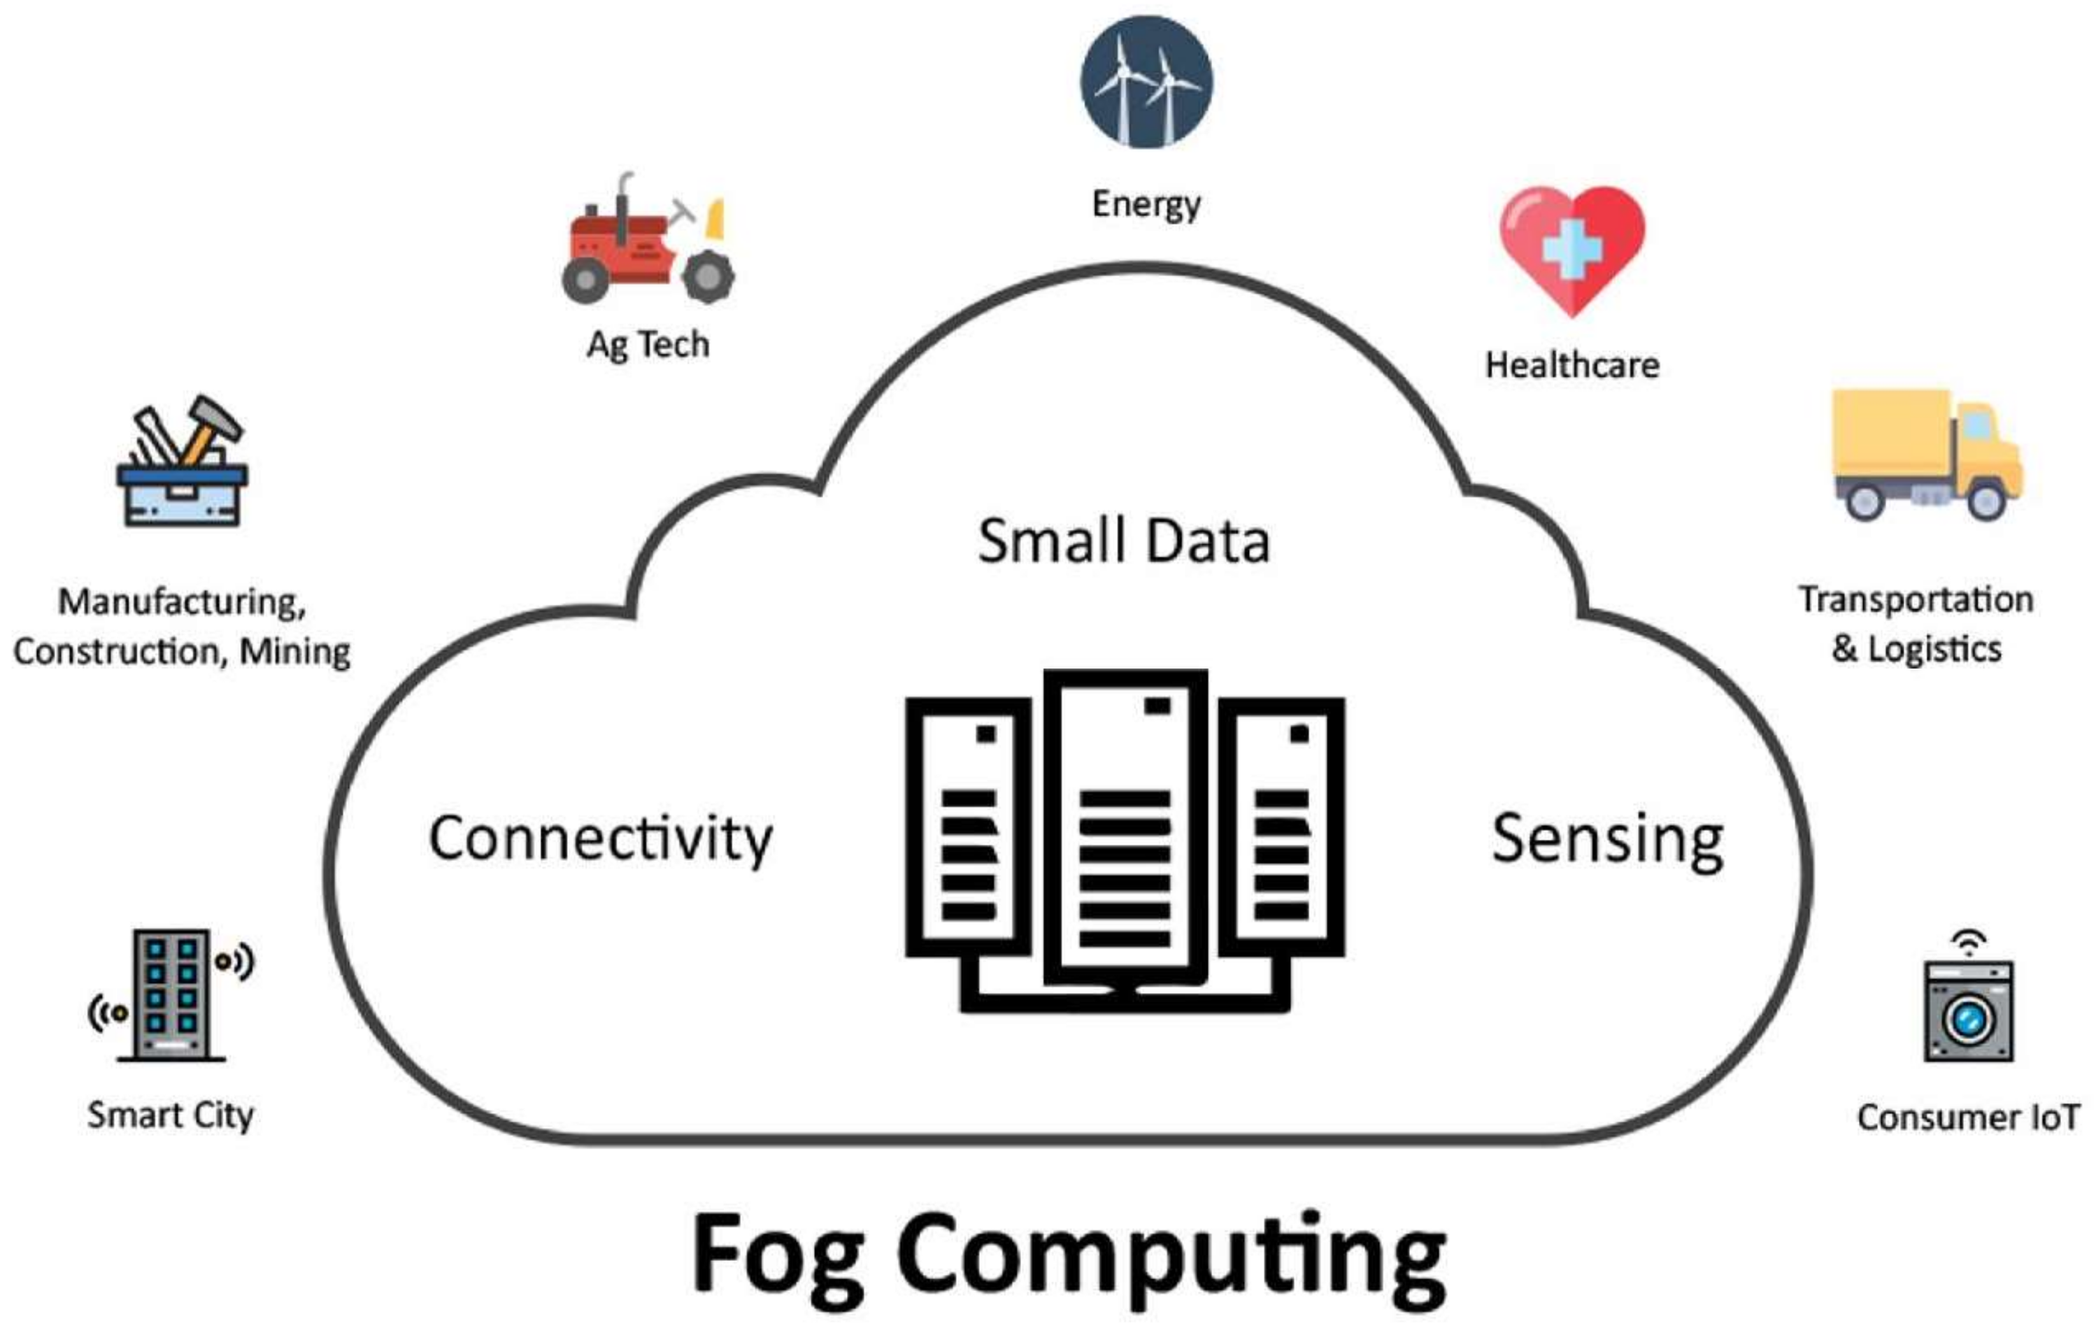
Literature Survey
Paper Name: Survey of Fog Computing: Fundamental, Network Applications, and Research Challenge
Authors: Mithun Mukherjee, Lei Shu, Di Wang
Published Date: 2018
Learning:

Slide 8
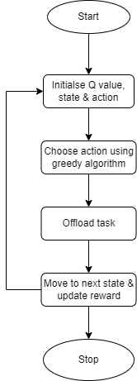
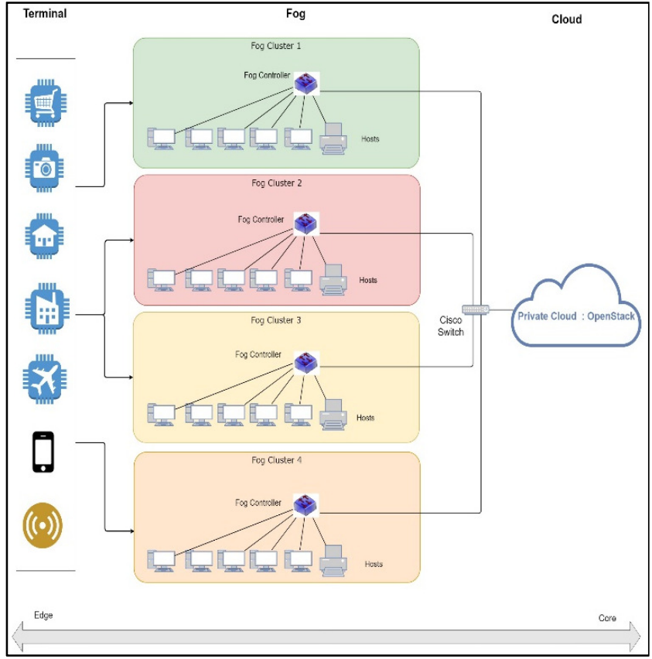
Literature Survey
2. Paper Name: ReTra: Reinforcement based Traffic Load Balancer in Fog based Network
Authors: Divya.V , R. Leena Sri
Published Date: July 8 2019
Learning:
Proposed architecture and algorithm

Slide 9
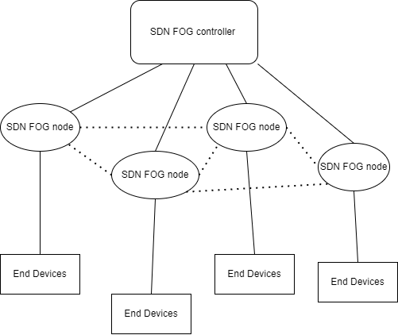
Literature Survey
3. Paper Name: Managing Fog Networks using Reinforcement Learning Based Load Balancing Algorithm
Authors: Jung-yeon Baek, Georges Kaddoum, Sahil Garg, Kuljeet Kaur , and Vivianne Gravel
Published Date: 28 Jan 2019
Learning:

Slide 10
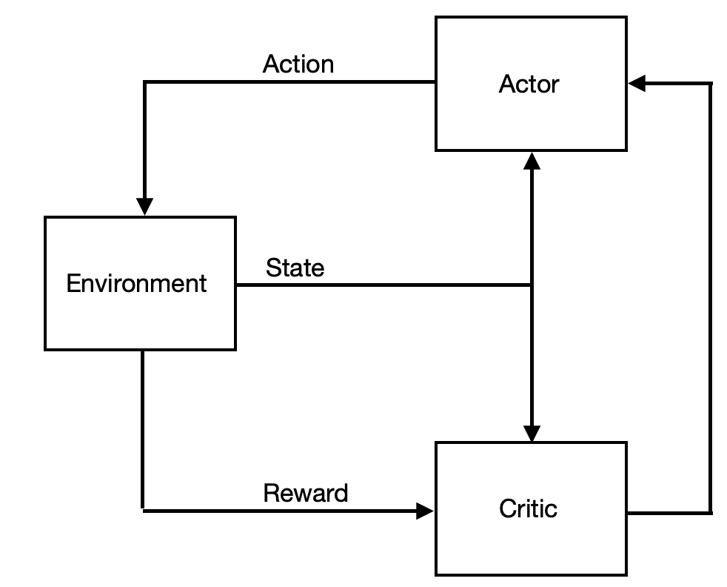
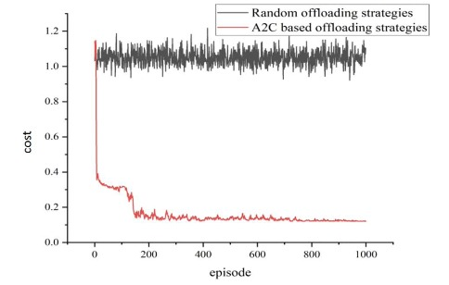
Literature Survey
4. Paper Name: Deep Reinforcement Learning for Joint Offloading and Resource Allocation in Fog Computing.
Authors: Wenle Bai , Cheng Qian
Published Date: 2021
Learning: The algorithm proposed in this paper is Advantage Actor Critic Algorithm(A2C) and it uses Deep Reinforcement Learning.

Slide 11
Literature Survey
4. Paper Name: Deep Reinforcement Learning for Joint Offloading and Resource Allocation in Fog Computing.
Authors: Wenle Bai , Cheng Qian
Published Date: 2021
Learning: The algorithm proposed in this paper is Advantage Actor Critic Algorithm(A2C) and it uses Deep Reinforcement Learning.

Slide 12
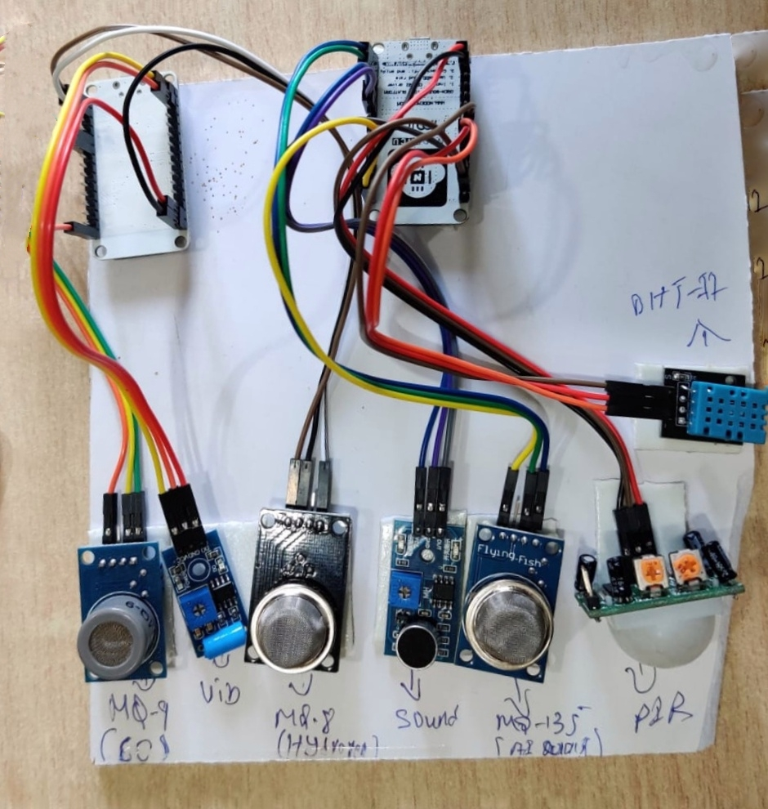
Dataset and Expected Output
Live data set is collected from the campus from the below prototype.
The data is obtained in an excel sheet which contains information about Temperature, Humidity, Hydrogen levels, Carbon Monoxide levels, Air Quality index.
Expected Output: Achieving effective offloading and load balancing between fog nodes such that the load is distributed.

Slide 13
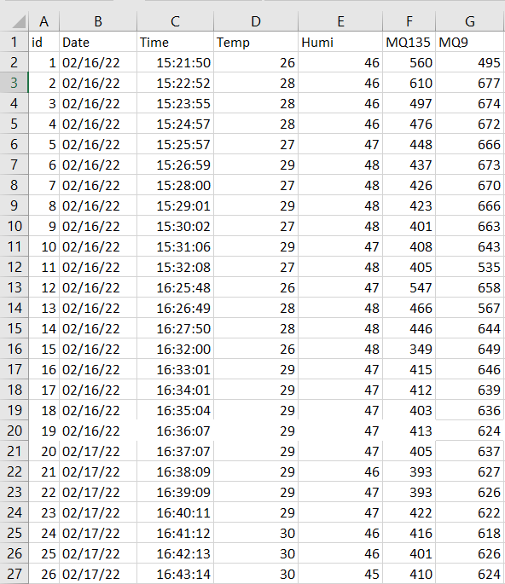
Dataset Collected From Campus
Sensors used:
Temperature sensor
Humidity sensor
MQ135: Air quality sensor
MQ9: Carbon monoxide sensor

Slide 14
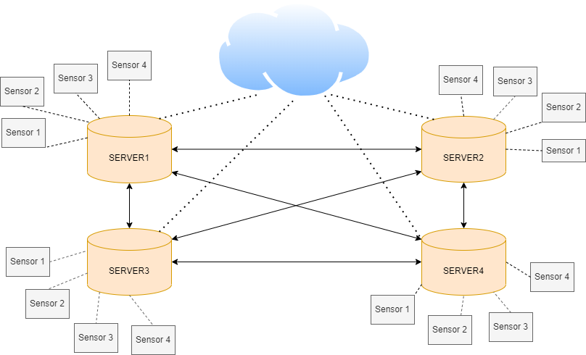
Architectural Design
Client and server architecture

Slide 15
System Design
The proposed load balancing uses Q learning which consists the following tuples:
F : set of fog nodes
M : set of IoT devices
dₘ : maximum allowed delay for m^{th} IoT device ∀ m ∈ M
tₘ : actual processing time for m^{th} IoT device ∀ m ∈ M
S : set of states.
s1 : 0 – 0.6 ( low load state )
s2 : 0.6 – 0.8 ( medium load state )
s3 : > 0.8 ( high load state )
The states represent the load value of fog node f ∈ F
A : set of actions defined as A = {(P(B) – Ø) ∪ ac } , where B = { bᵢ : i = 1 to | F | }and ac is action representing offloading to cloud.
R(s , a) : Reward function is calculated as,
R(s , a) = tanh(D) , where D = dₘ - tₘ

Slide 16
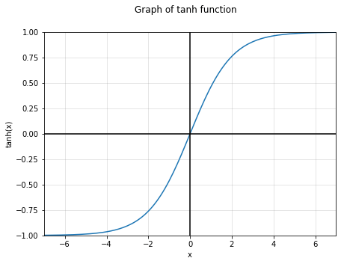
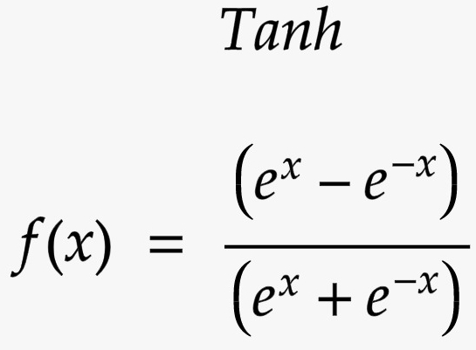
Reward Function

Slide 17
Proposed Algorithm
Input :
λf (Arrival rate of the packets in the fog node f ∈ F following Poisson distribution)
∝ (Learning rate )
ε (Exploration policy)
𝚪 (discount factor)
μ (Processing rate of the server following exponential distribution)
dₘ (Allowed latency constraint of a sensor)
Output :
Fog nodes selected for offloading and the percentage of packets served within latency constraint.

Slide 18
Proposed Algorithm
Q learning algorithm
Steps :
Q(s , a)←0, ∀ s ∈ S, ∀ a ∈ A //initialize Q values states and actions.
Repeat
| choose action a ∈ A based on epsilon greedy algorithm
| offload packets to neighbours based on chosen action a.
| Receive D from neighbours
| Calculate reward R(s,a) = tanh(D)
| Update Q table using Q(s , a) = ∝ [R(s , a)+𝚪 ⨉ max Q(s`,*)]+(1- ∝)Q(s , a)
| move to next state s ← s`

Slide 19
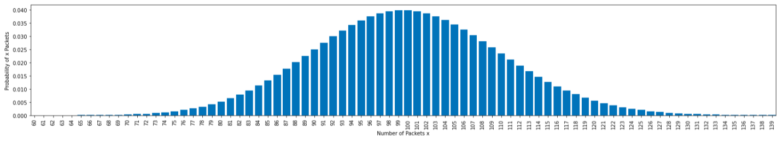
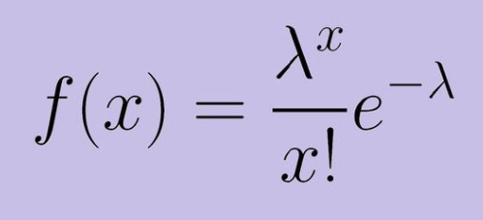
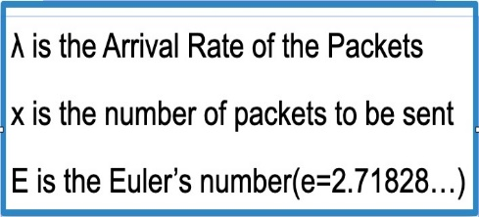
Implementation
Graph of Probability mass distribution

Slide 20
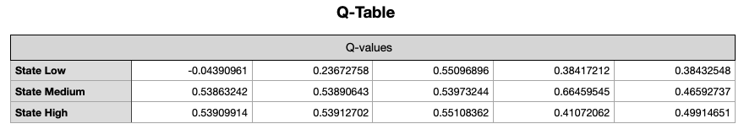
Implementation

Slide 21
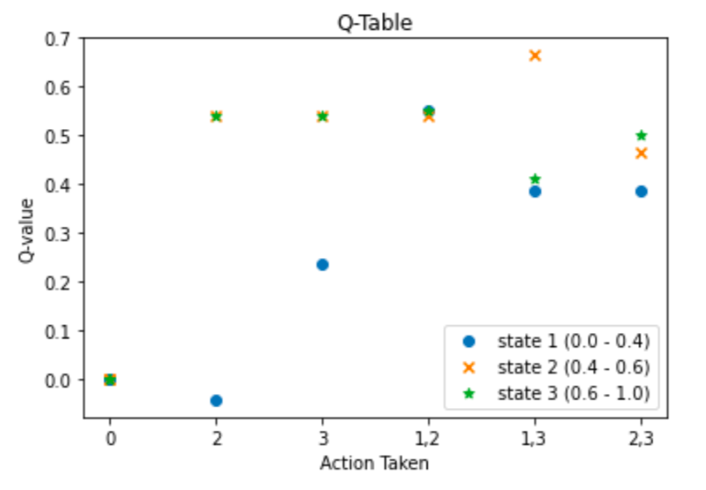
Implementation

Slide 22
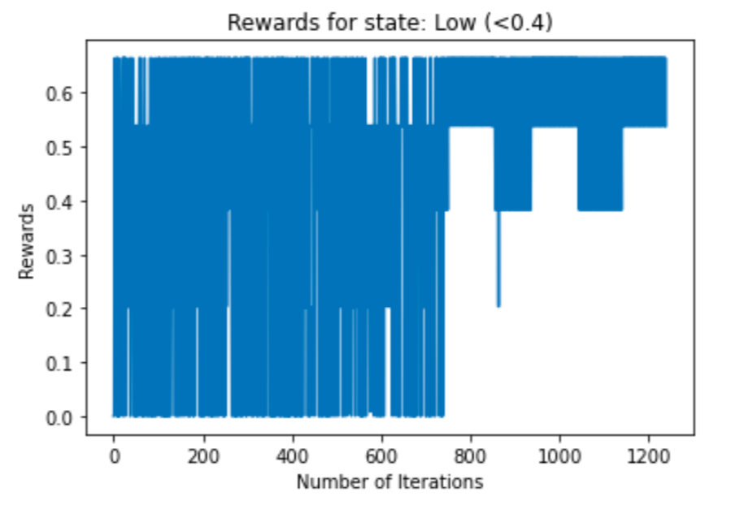
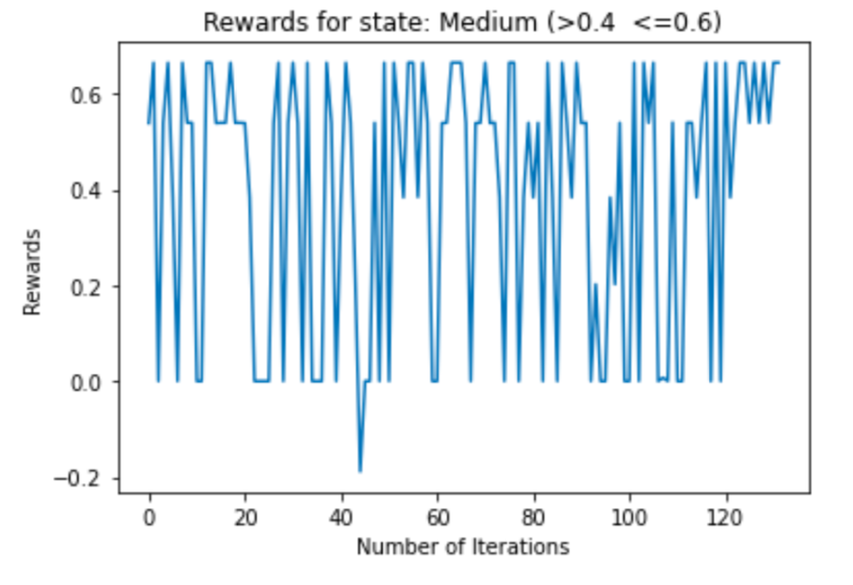
Implementation

Slide 23
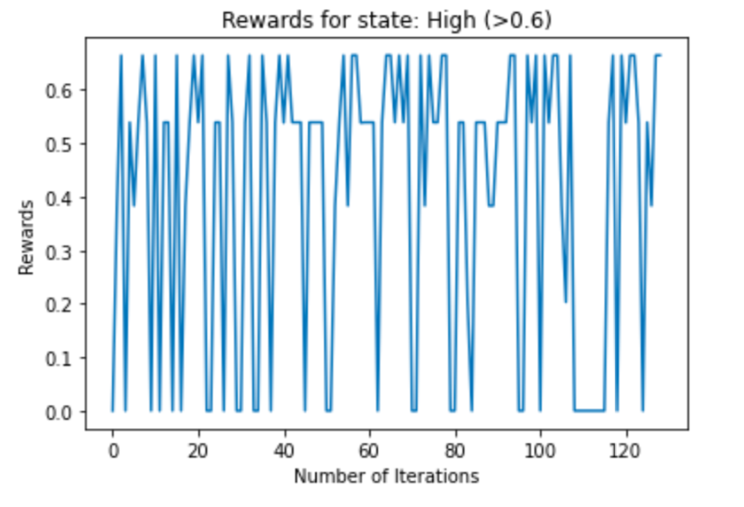
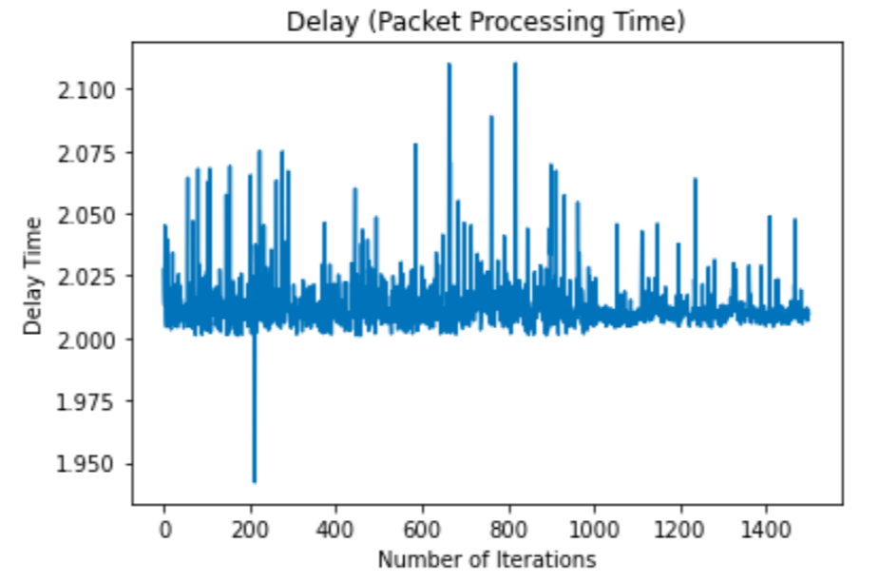
Implementation

Slide 24
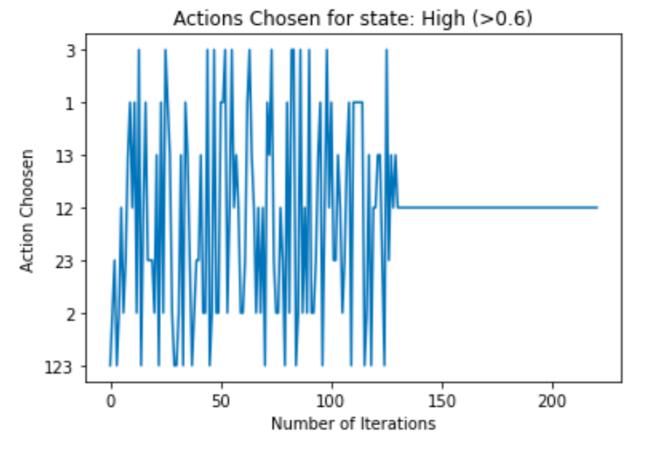
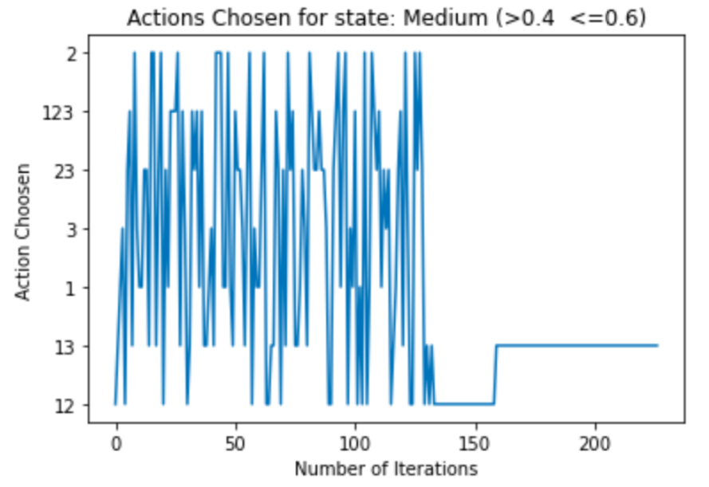
Implementation

Slide 25
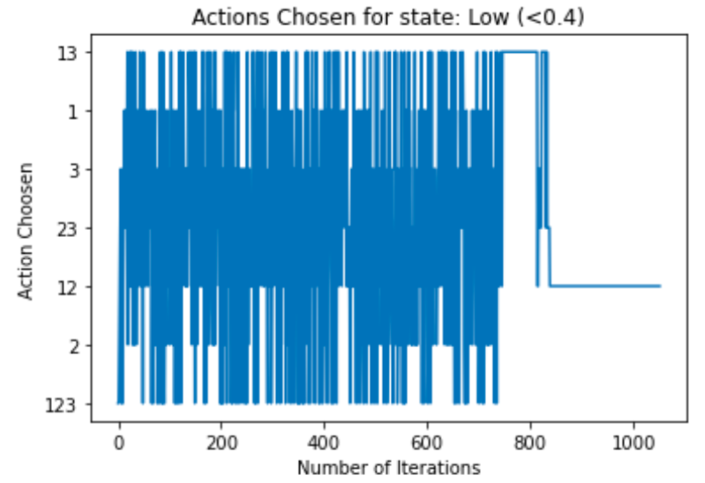
Implementation

Slide 26
References
M. Mukherjee, L. Shu and D. Wang, "Survey of Fog Computing: Fundamental, Network Applications, and Research Challenges," in IEEE Communications Surveys & Tutorials, vol. 20, no. 3, pp. 1826-1857, thirdquarter 2018.
J. -y. Baek, G. Kaddoum, S. Garg, K. Kaur and V. Gravel, "Managing Fog Networks using Reinforcement Learning Based Load Balancing Algorithm," IEEE Wireless Communications and Networking Conference (WCNC), 2019, pp. 1-7
V. Divya and R. L. Sri, "ReTra: Reinforcement based Traffic Load Balancer in Fog based Network," 2019 10th International Conference on Computing, Communication and Networking Technologies (ICCCNT), 2019, pp. 1-6
W. Bai and C. Qian, "Deep Reinforcement Learning for Joint Offloading and Resource Allocation in Fog Computing," 2021 IEEE 12th International Conference on Software Engineering and Service Science (ICSESS), 2021, pp. 131-134

Slide 27
Thank You

